Slide 1
PRODUCT SALES ANALYSIS
Presented by
A.Kavipriya
J.L.Manovathi
G.Priyadharshini
B.Sweatha

Slide 2

Problem Definition
The problem of product sales analysis involves examining and understanding the performance of products sold by a company or business over a specific period. This analysis aims to provide valuable insights to support decision-making, optimize inventory, improve marketing strategies, and enhance overall profitability.

Slide 3

Key Components:
Data Collection
Data Preparation
Metrics
Exploratory Data Analysis
Segmentation
Time Series Analysis
Customer Behavior Analysis
Reporting and Visualization
Continuous Monitoring

Slide 4

Design Thinking –Analysis Objective
The objective of product sales analysis is to gain valuable insights and make data-driven decisions to improve the performance and profitability of a product or product line.
It including,
Sales Performance Assessment
Market Segmentation
Demand Forecasting
Customer Behavior Analysis
Price Optimization
Geographic Analysis
Customer Feedback Analysis
Seasonal and Trend Analysis

Slide 5
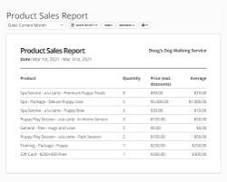
Design Thinking-Data Collection
Collecting data for product sales analysis is a critical step to gain insights into your business's performance.
Sales Records: Start with your sales records, which should include detailed information on each transaction.
Customer Data: If applicable, collect customer data to understand buying patterns and segment your customer base.
Marketing and Promotions Data: Gather data on marketing campaigns, promotions, and discounts that may have influenced product sales.
Customer Feedback and Reviews: Incorporate qualitative data from customer feedback, surveys, and product reviews.

Slide 6
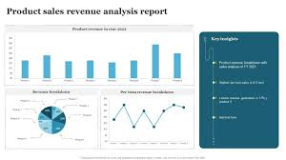
Design Thinking –Visualization Strategy
Visualizations make complex data more understandable and actionable. Strategies are:
Dashboard Overview
Sales Trends Over Time
Product Performance
Product Category Analysis
Sales by Location
Customer Segmentation
Marketing Impact
Customer Feedback
Mobile Responsiveness

Slide 7
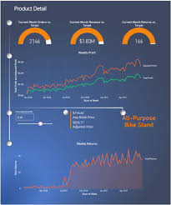
Design Thinking –Actionable Insights
In a product sales analysis, actionable insights are crucial for making informed decisions and improving business performance. Here are some actionable insights you can derive from your analysis:
Identify Top-Performing Products
Stock Optimization
Price Adjustments
Product Improvement
Cross-Selling Opportunities
This strategies that can be implemented to improve product sales, customer satisfaction, and overall business performance

Slide 8
Thank you

